Slide 1
Robotics Process Automation
WHAT, WHY AND HOW

Slide 2
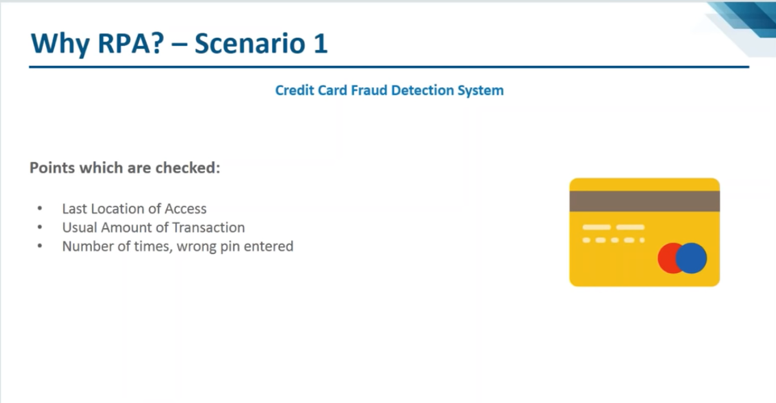

Slide 3
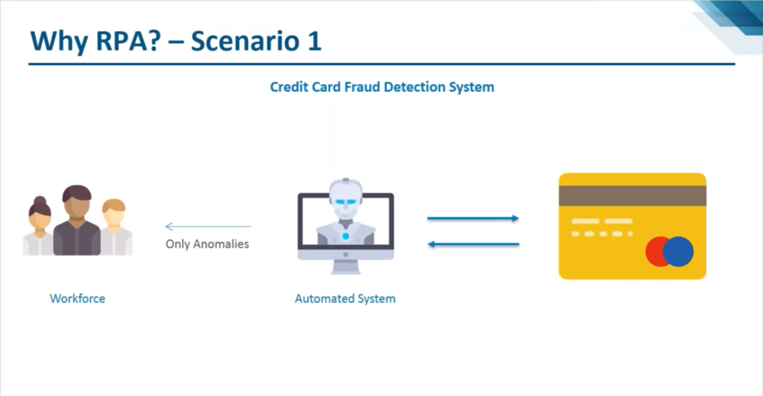

Slide 4
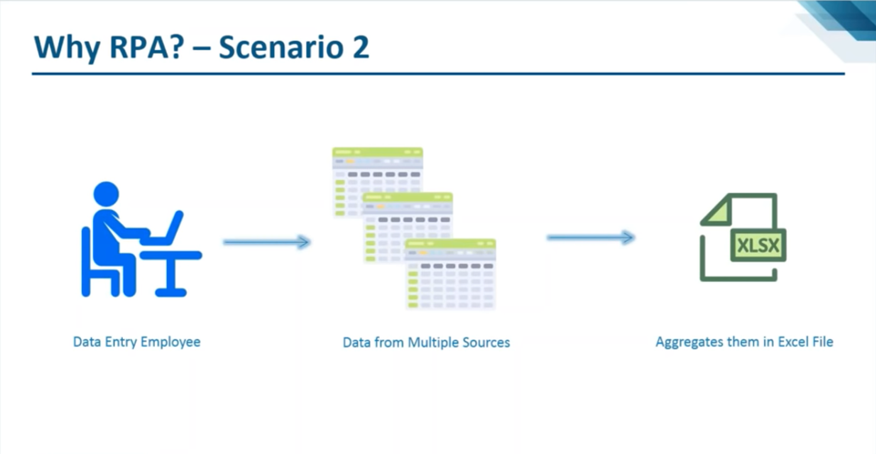

Slide 5
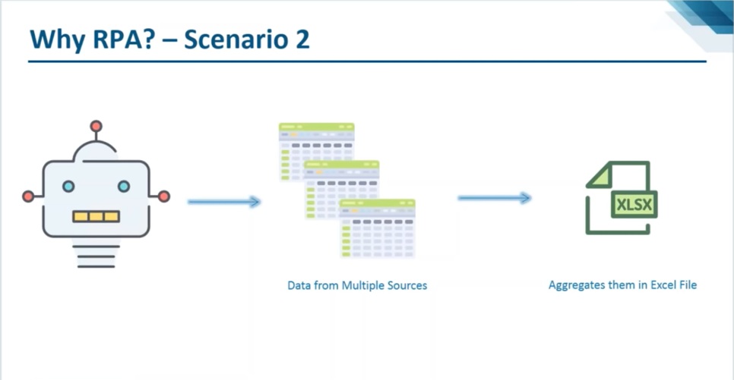

Slide 6
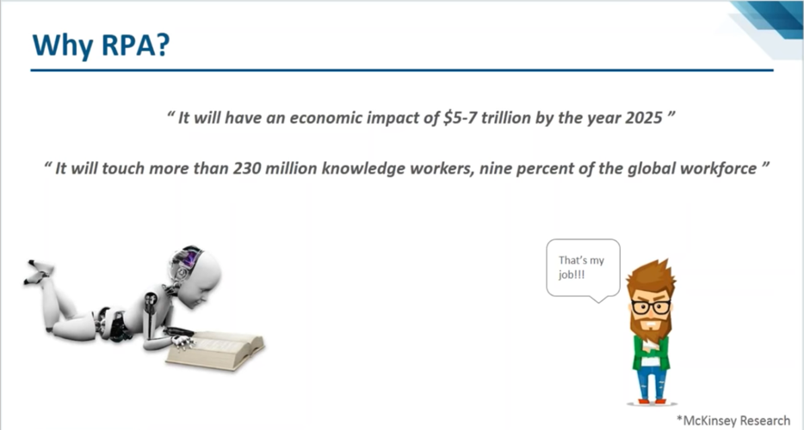

Slide 7
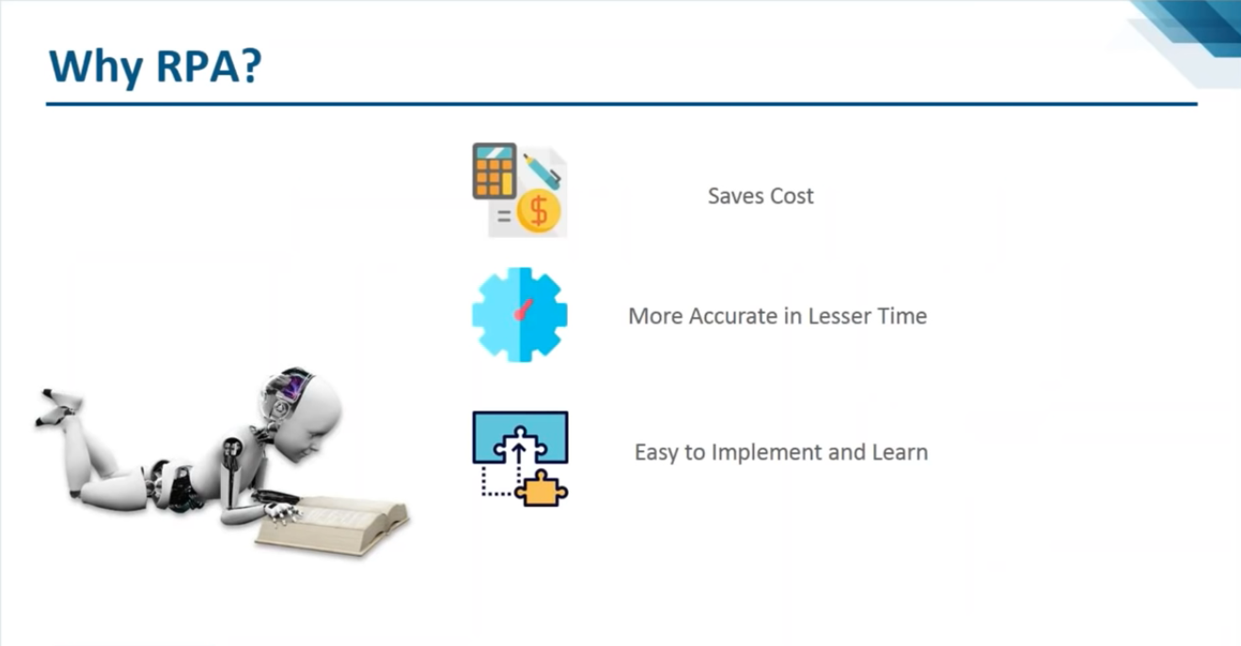

Slide 8
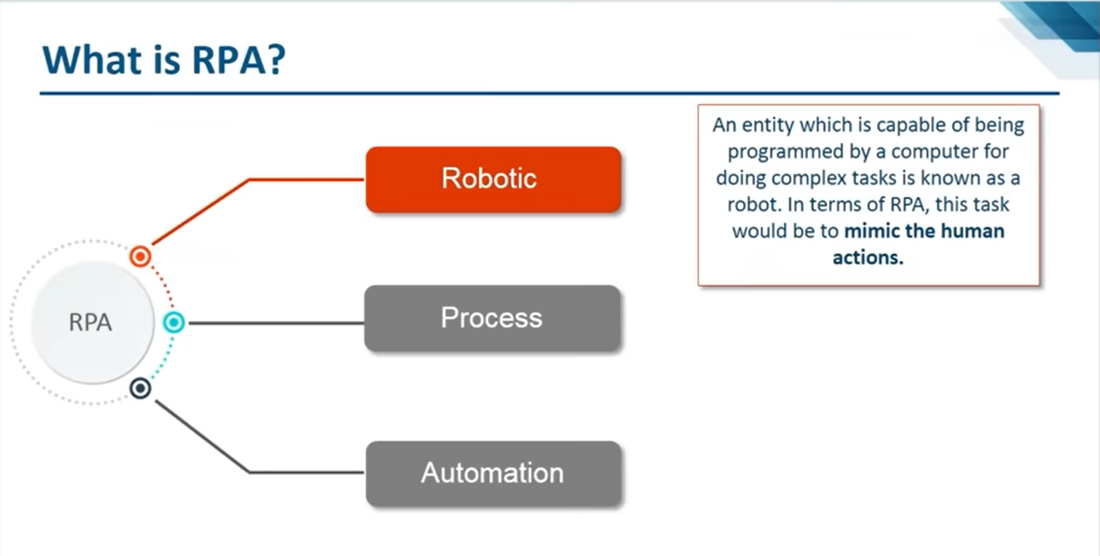

Slide 9
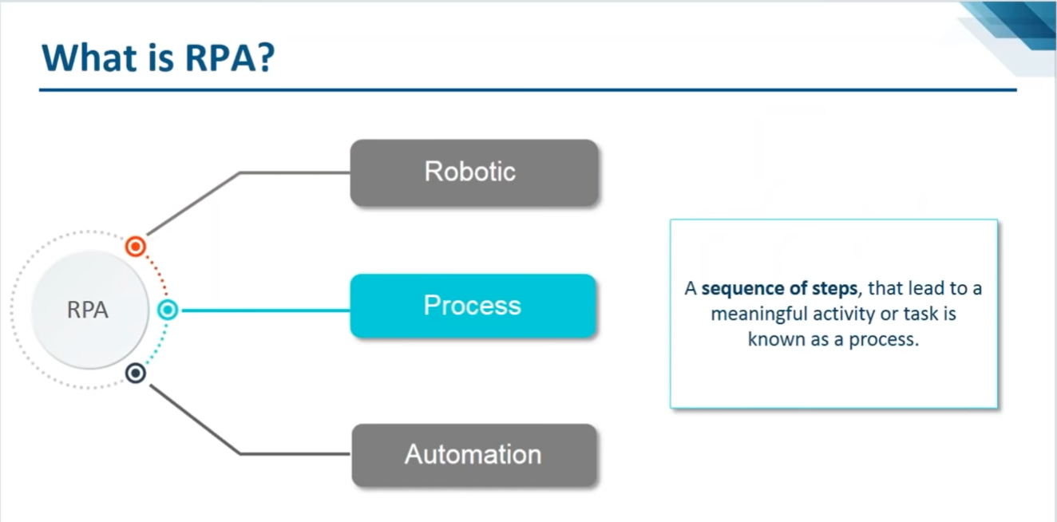

Slide 10
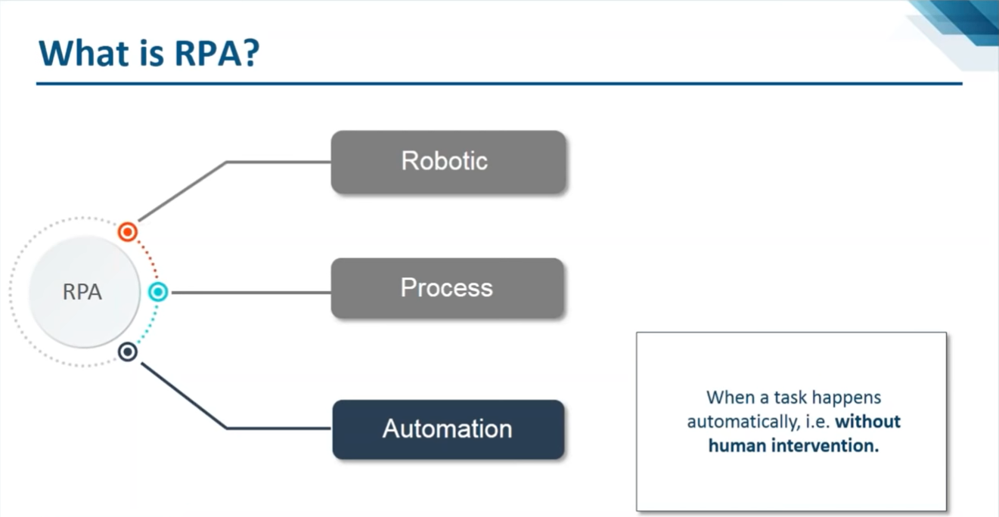

Slide 11
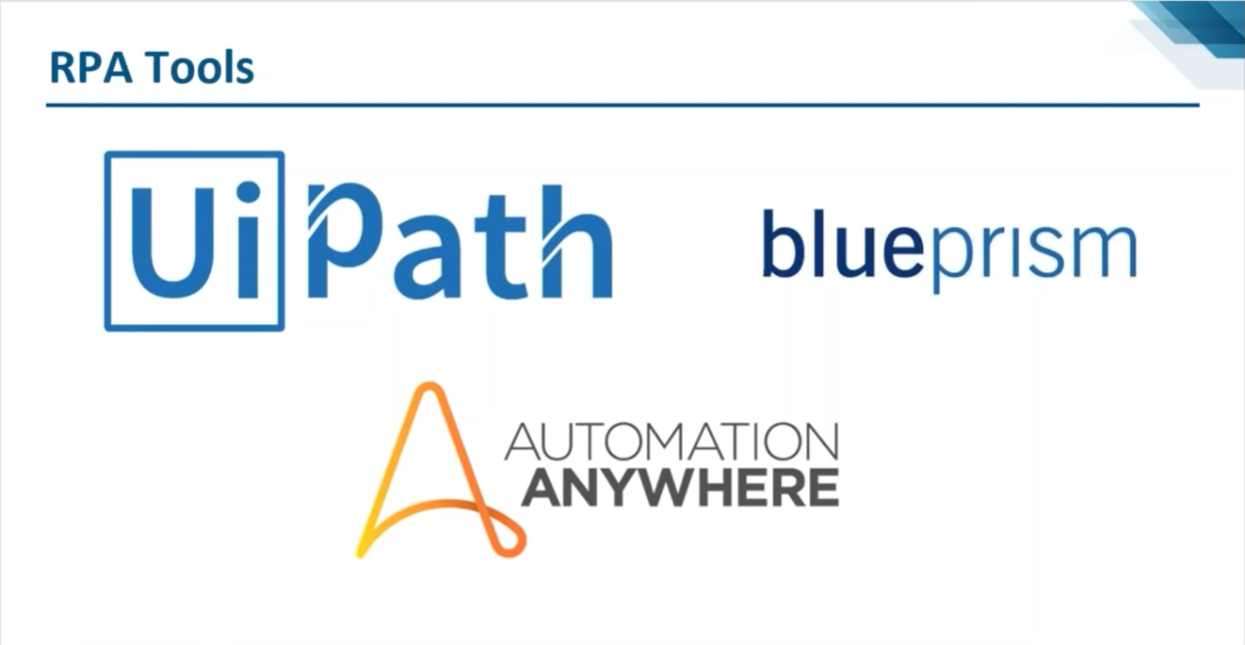

Slide 12
WHAT IS RPA and How it is Different from Cognitive Intelligence?

Slide 13
RPA History & Terminologies:
RPA emerged in the 2000s – Blue prism released their first product in 2003, UiPath and Automation anywhere released their automation libraries around the same time
RDA : Robotic Desktop Automation tools install on a single machine for one user and can perform data scraping, Excel automation, file transfers, report generation
RPA : Robotic Process Automation - business process automation technology based on software robots (bots) or on Artificial Intelligence (Structured + Semi structured) (Ex: Invoice Processing)
IPA : Intelligent Process Automation (Decision power, Unstructured, Intelligent Process)
C/AI : Cognitive / Artificial Intelligence (RPA + Unstructured)
NLP : Natural Language Processing
BOT : BOTS are configurable software set up to perform the tasks you assign and control.
BOT is a software application that runs automated tasks (scripts) over the Internet.
Structured data means the data have the schema. data should be structured format like tabular rows and columns format.
Semi-structured means some raw data like JSON and XML data.
Unstructured data means the data should not have any schema like videos ,images ,logs
Attended BOTS are the once which require human intervention (Front End)
Unattended BOTS are the once which doesn’t require human intervention (Back End)

Slide 14
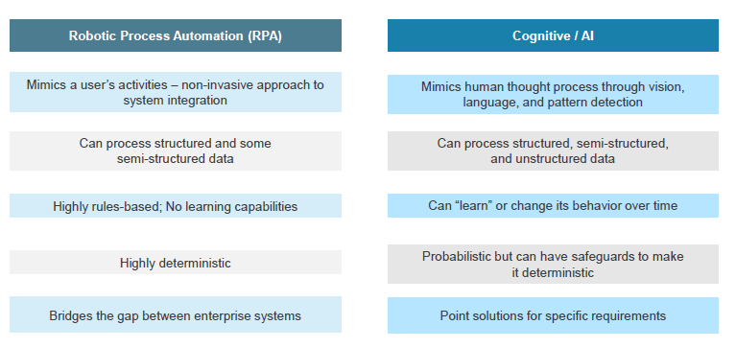
RPA and AI are the key components of SDA with different approaches to solve business problems

Slide 15
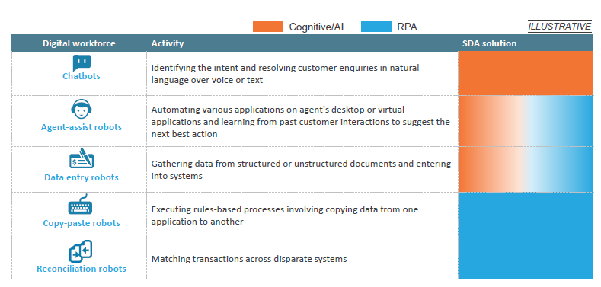
When combined together, RPA and AI create a smart digital workforce and can lead to end-to-end process automation

Slide 16
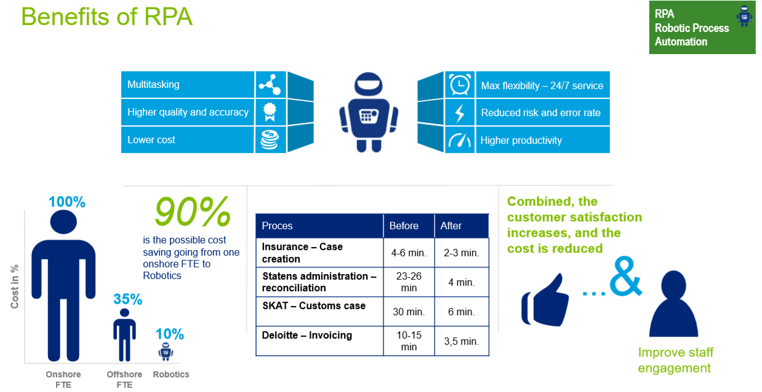

Slide 17
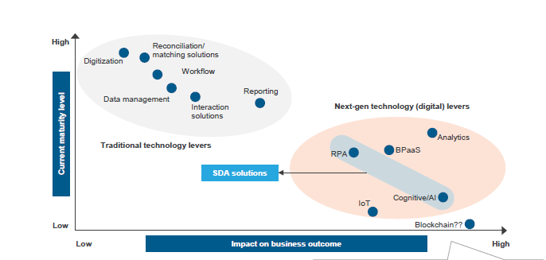
Among the various next-generation technology levers in global services, Service Delivery Automation (SDA) is the most powerful

Slide 18
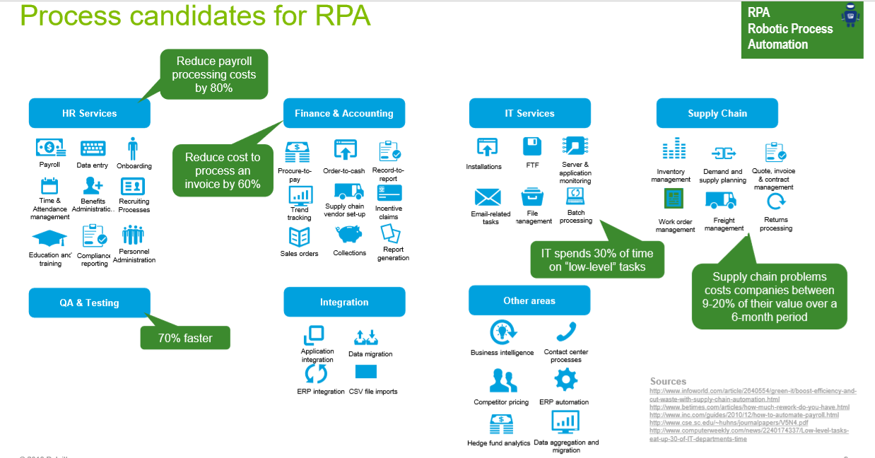

Slide 19
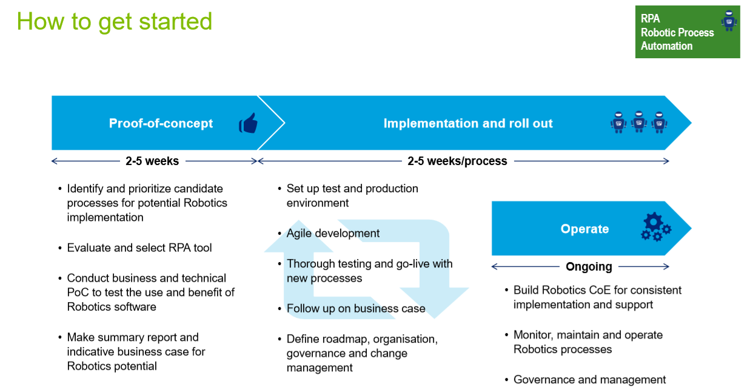

Slide 20
About RPA Market Size

Slide 21
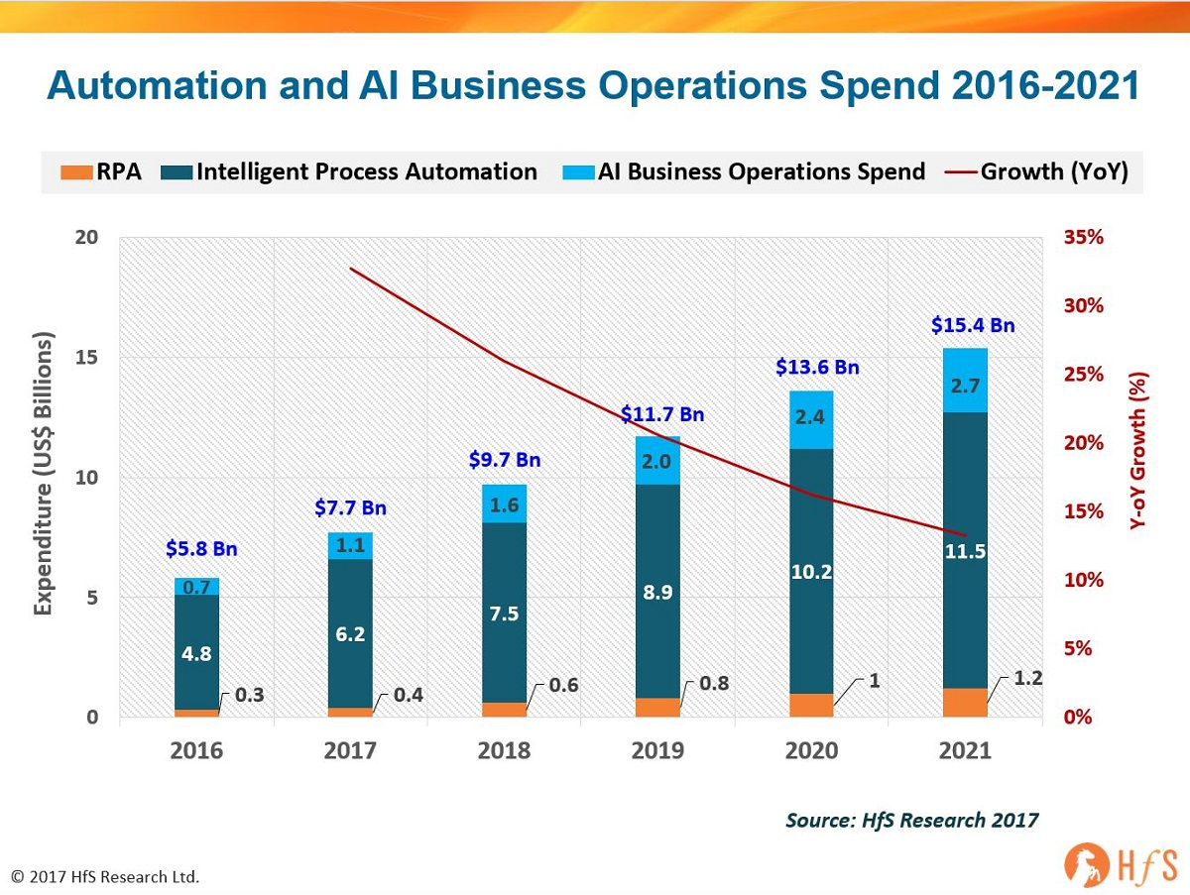
Market Size for Robotics Process Automation and Big Data Analytics

Slide 22
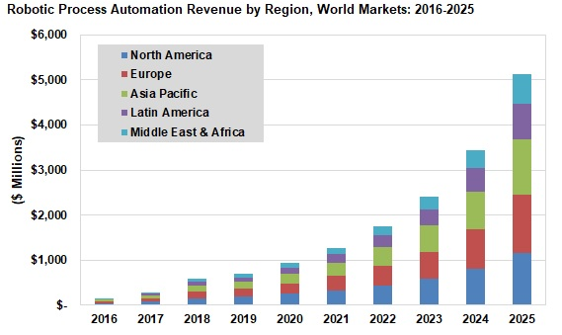

Slide 23
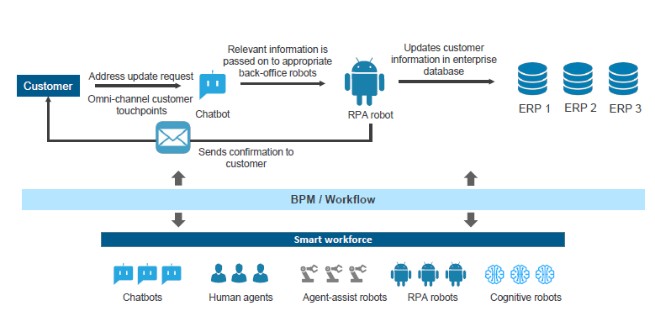
Smart workforce is leveraged for digital transformation of business operations

Slide 24
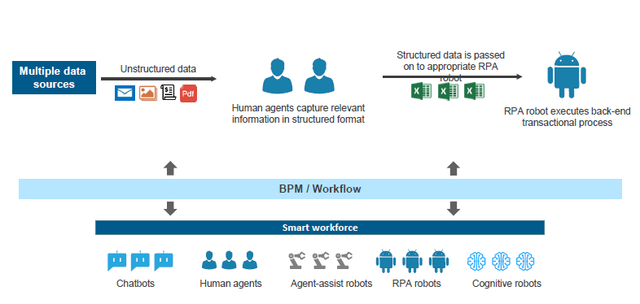
Smart workforce is leveraged for digital transformation of business operations

Slide 25
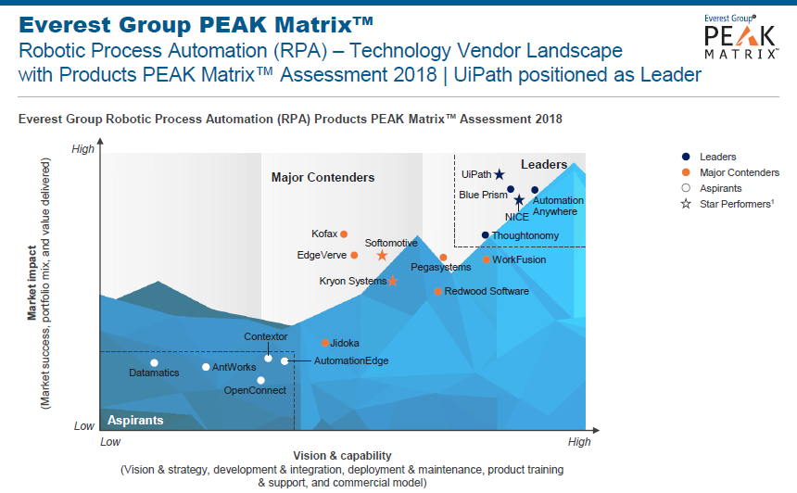
RPA Product – Gartner/Everest Rating

Slide 26
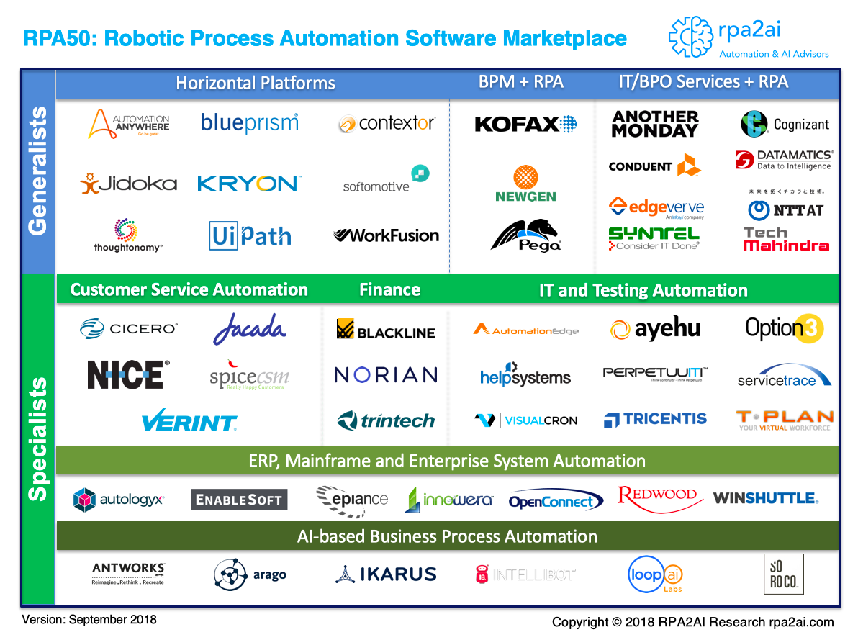

Slide 27
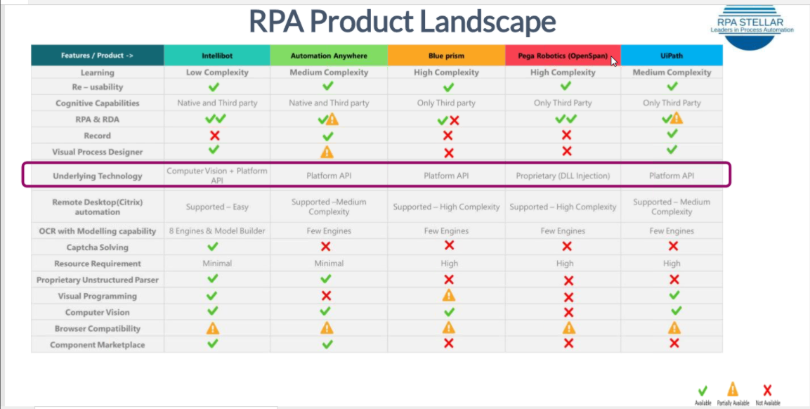

Slide 28
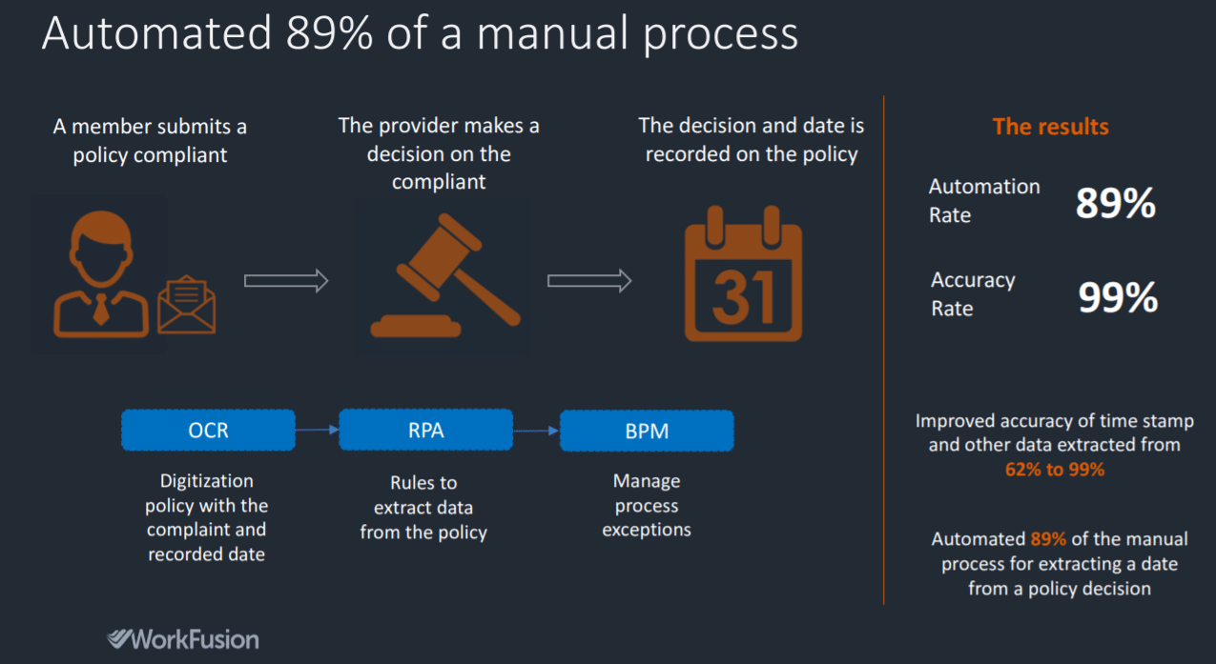
Industry Specific Use Cases – Insurance Appeal Process

Slide 29
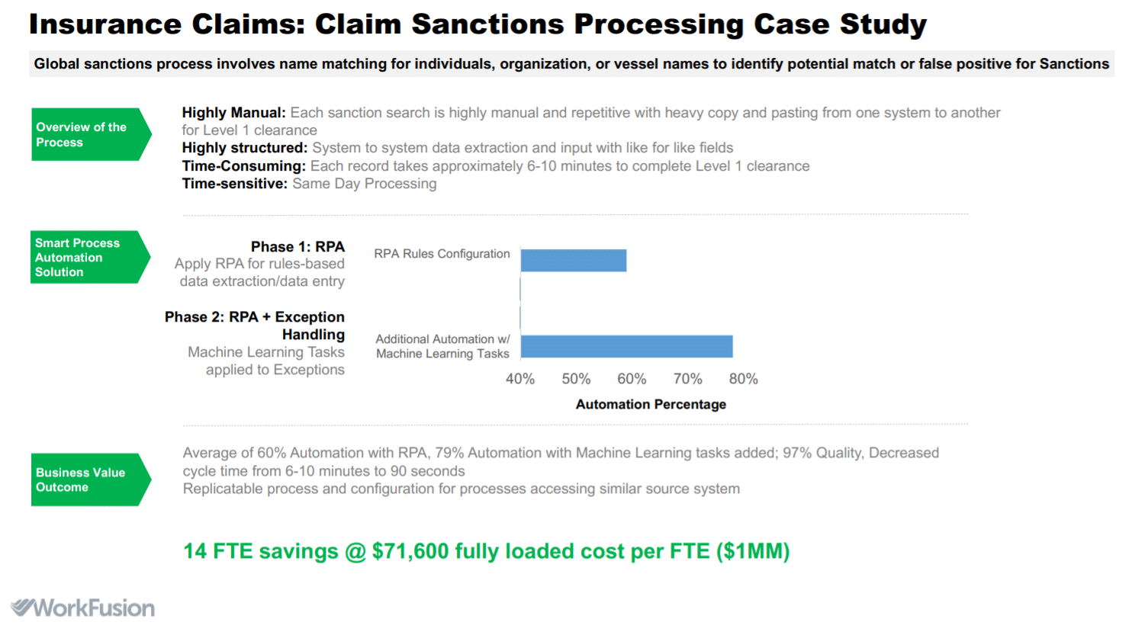
Industry Specific Use Cases – Insurance Claim Processing

Slide 30
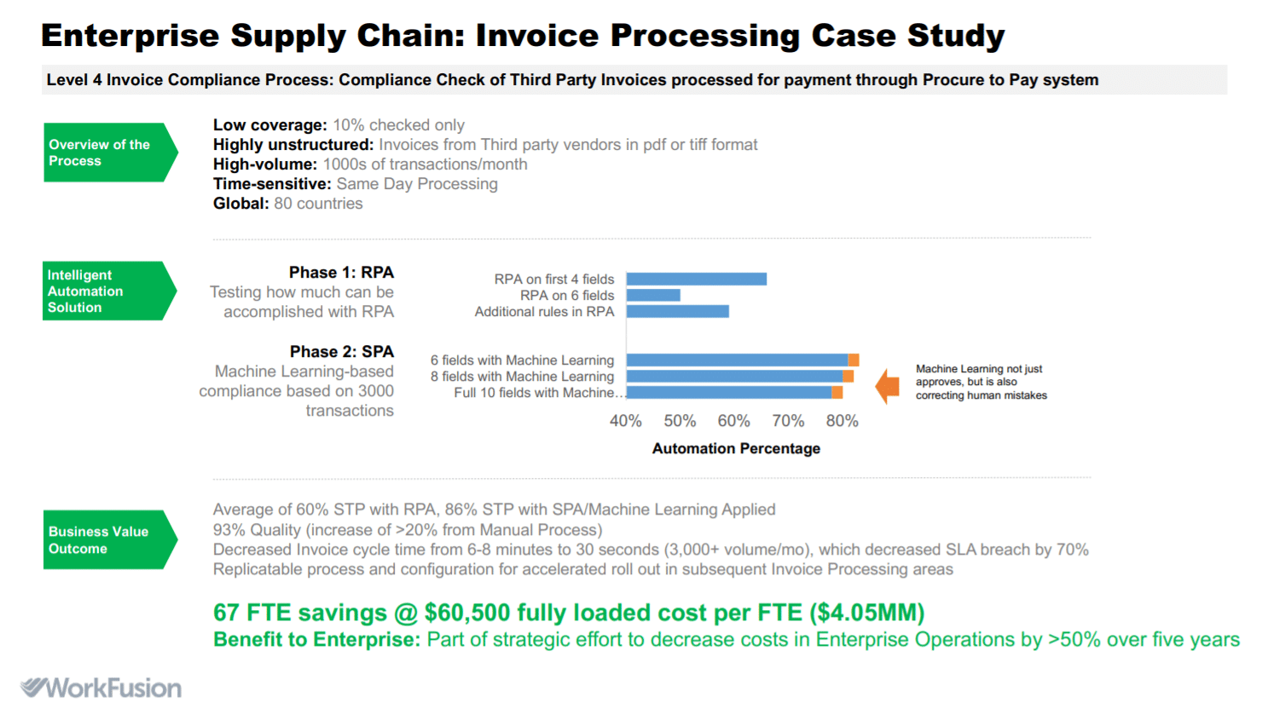
Industry Specific Use Cases – Invoice Processing

Slide 31
STEP BY STEP APPROACH FOR RPA
IMPLEMENTATION and FRAMEWORK

Slide 32
Robotics Process Automation Framework & Solution Tenets are based on Six Sigma DMAIC approach for effective implementation and continuous Improvements
360 DEGREE RPA ROLL OUT PLAN
DESIGN
MEASURE
ANALYSIS
IMPLEMENTATION
CONTROL
ONGOING IMPROVEMENS

Slide 33
Effective Onboarding results in successful roll outs for our RPA Solution as Customer is always the Fulcrum of the overall implementation
Design
Measure
Analytics
Implementation
Control & Continuous Improvement
Process Understanding
Input / Output Source Management and discovery
Understanding of AS IS Infrastructure and Connectivity of Systems
Business Understanding and Controls within AS IS Process
Understanding Current Challenges
Volume Analysis
Measure the overall Volume Arrival Pattern of the Business
Measure and Understand the overall Systems, Connectivity and Overall Downtime Management Schedule
Bifurcate the Processes for Attended Vs Unattended Steps within Process
Create TO BE Process for Implementation
Risk Mitigated Approach for TO BE PROCESS MAPS
Interlink and Connectivity with Systems and RPA BOTS
System Integration Framework and BOT Framework for Implementation
Customer Sign Off on TO BE PROCESS MAP
Create BOT and Program as per Signed Off TO BE Process
Testing through Test Cases across the In Scope Operations
Host the Bots into RPA Framework
Soft Go Live on the Process
Roll Out the BOTS across Customer Operations
Dashboard : Exception Management and Bot Management
BOT efficiency management for minimizing Falls outs and Exceptions
Continuous Improvements across BOT for effective Operations
Bring Cognitive Features within the BOTS implemented
BOT Rationalization for effective cost optimization

Slide 34
Q & A

Slide 35
Thank You

